Slide 1
Computer Applications
Lecture 3
Building A Personal Computer

Slide 2
During the last lecture …
We found out about the various types, big and small, fast and slow, cheap and expensive. Our main categories were:
    Super computers
    Mainframes
    Servers
    Desktops
    Mobile computers

Slide 3
Today’s goal is quite simple …
To learn about the various components of the popular personnel computer and how those things are put together to form a PC

Slide 4
PC Parts
Monitor/ LCD / LED (show cables; the tube)
Keyboard
Mouse (inside)
Speaker/headphone
Microphone
CPU
  Front buttons
  Backside ports, fan, slots, cables

Slide 5
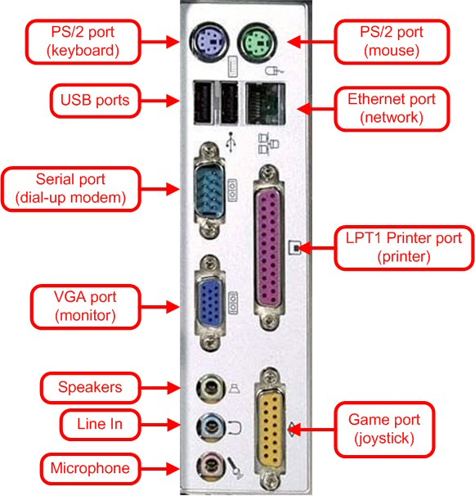
PC Ports

Slide 6
Inside of the CPU
Power supply/fan & connectors
Motherboard
  Bus
  Edge connectors
  Ports
Video card
Modem/ NIC
Network card
Sound card
ROM
RAM
  Slots
  DIMM’s

Slide 7
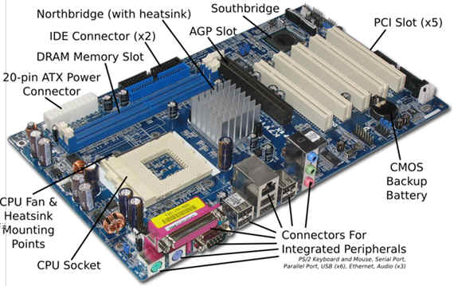
Inside of the CPU

Slide 8
The Processor Module
The slot on the motherboard
The housing
  Fan
  Heat sink
Pins (256?), Transistors (10 million?)

Slide 9
What have we learnt today?

